Slide 1



Data Science and Machine Learning
Generative AI

Slide 2
Generative AI & Large Language Models

Slide 3
Generative AI
ChatBot
Who designed the street layout of Washington DC?
T
The street layout of
Washington D.C. was designed by Pierre Charles L'Enfant, a French-born American architect and civil engineer.

Slide 4
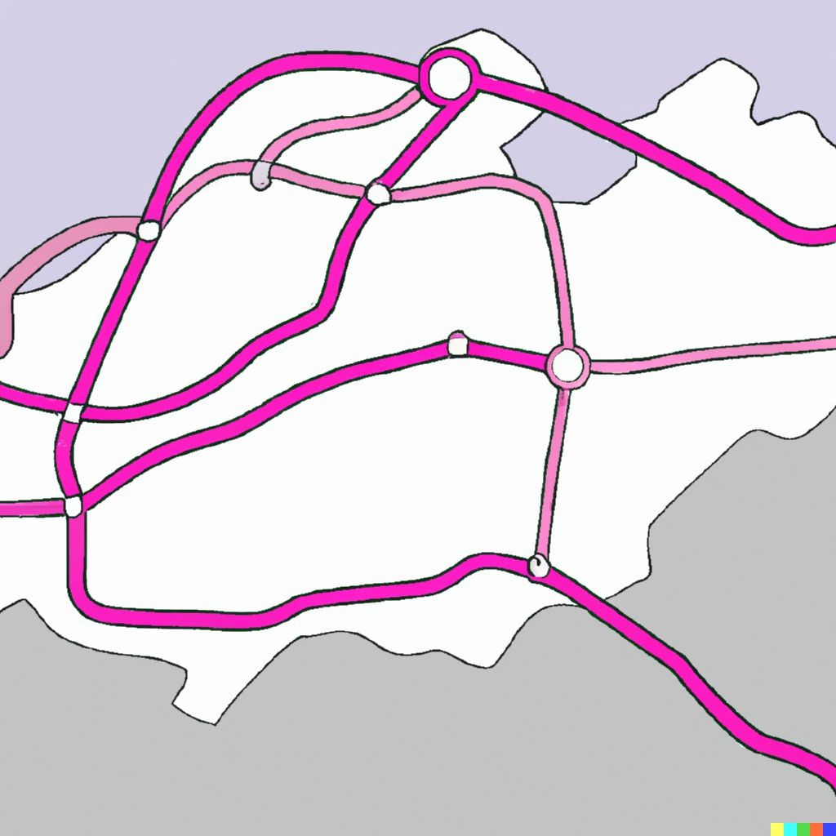
Generative AI
pAIntBox
What do you want to create?
An | imaginary | subway | map
in | a coastal | city.
Image dimensions:
by
(Max 2048)
Generate

Slide 5

Large Language Models
BLOOM
GPT
LLaMa
BERT
PaLM
FLAN-T5

Slide 6

The significance of scale: language understanding
BERT* 110M
*Bert-base
BLOOM 176B

Slide 7


Prompts and completions
Prompt
Model
Completion
Where is Ganymede located in the solar system?
Where is Ganymede located in the solar system?
LLM
Ganymede is a moon of Jupiter and is located in the solar system within Jupiter’s orbit.
Context window
For exemple, a few 1000 words.

Slide 8
Use cases & tasks

Slide 9
LLM chatbot
ChatBot
Who designed the street layout of Washington DC?
T

Slide 10
LLM chatbot
ChatBot
Who designed the street layout of Washington DC?
T
The street layout of
Washington D.C. was designed by Pierre Charles L'Enfant, a French-born American architect and civil engineer.

Slide 11
LLM use cases & tasks
Essay Writing
Summarization
Translation

Slide 12
LLM use cases & tasks
Essay Writing
Summarization
Translation
Information retrieval
Invoke APIs and actions
Action call
External Applications

Slide 13
How LLMs work - Transformers architecture

Slide 14
Generating text with RNNs
RNN

Slide 15
Generating text with RNNs
?
The milk is bad, my tea
tastes …
great.
RNN

Slide 16
Generating text with RNNs
?
The milk is bad, my
tea tastes …
great.
RNN

Slide 17
Generating text with RNNs
?
The milk is bad
, my tea tastes …
great.
RNN

Slide 18
Generating text with RNNs
?
The milk is bad
, my tea tastes great.
RNN

Slide 19

Generating text with RNNs
The milk is bad, my tea tastes great.
RNN

Slide 20

Understanding language can be challenging
I took my money to the bank.
River bank?

Slide 21
Understanding language can be challenging
The teacher’s book?
The teacher taught the student with the book.
The student’s book?

Slide 22

RNN
The teacher taught the student with the book.

Slide 23
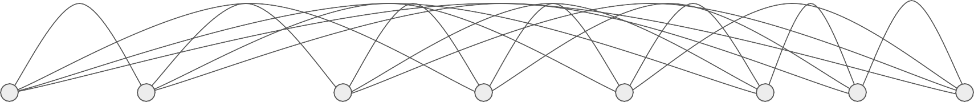
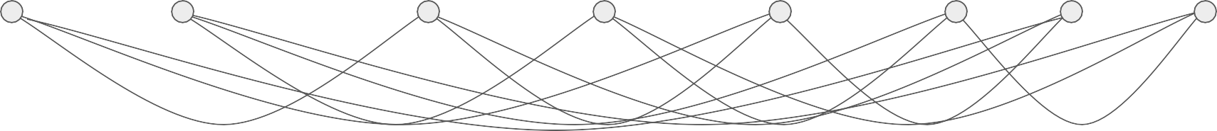
Transformers
The teacher taught the student with the book.

Slide 24
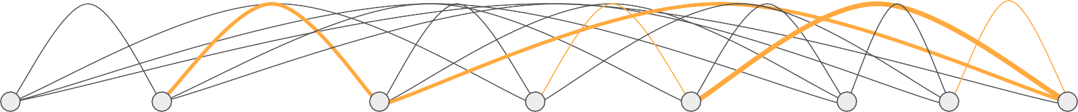
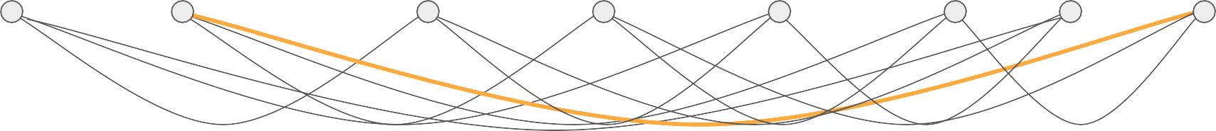
Transformers
The teacher taught the student with the book.

Slide 25
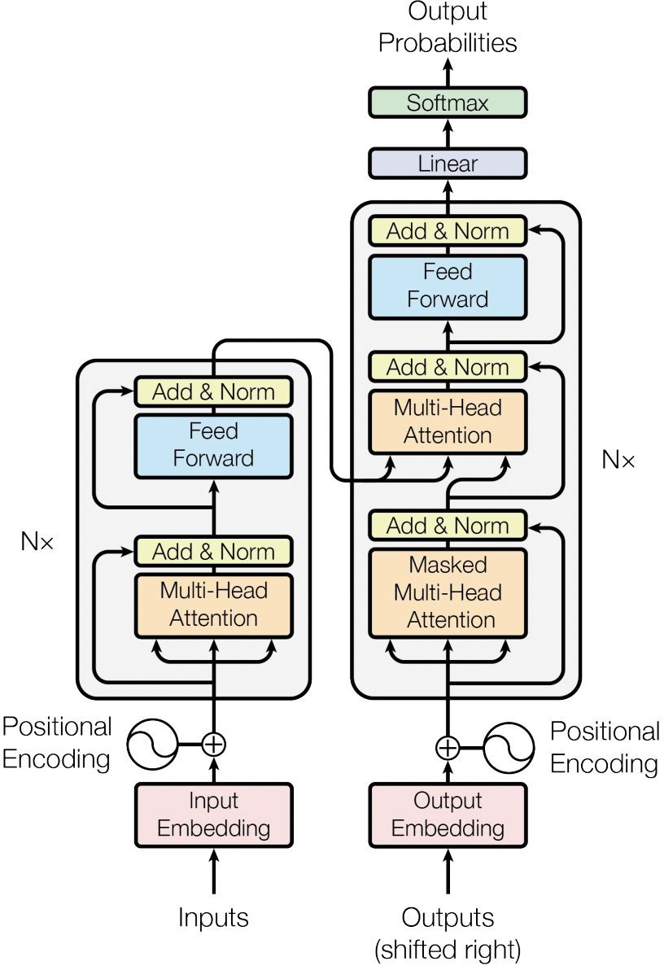

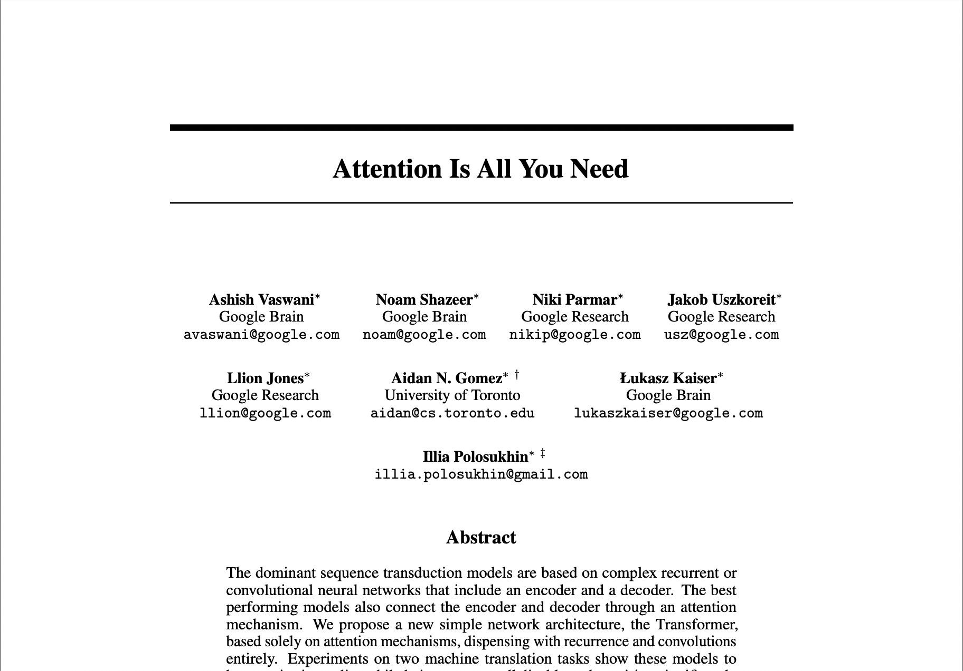
Transformers

Slide 26
Transformers
Scale efficiently
Parallel process
Attention to input meaning

Slide 27
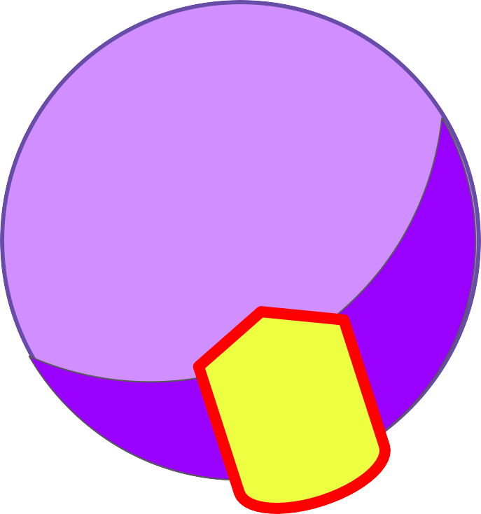

Transformers
RNN
LLM
L

Slide 28
Self-attention
The teacher taught
the student
with
a book
.
The teacher taught the student with
a book
.

Slide 29
Self-attention
The teacher taught
the student
with
a book
.
The teacher taught the student with
a book
.

Slide 30
Transformers

Slide 31
Transformers
Output
Softmax output
Decoder
Encoder
Embedding
Embedding
Inputs

Slide 32

Transformers
Decoder
Encoder
Embedding
Embedding
Inputs
Tokenizer
342 | 879 | 432 | 342
Token IDs
Input:
the teacher
taught the

Slide 33
Transformers
Decoder
Encoder
Embedding
Embedding
Inputs
Tokenizer
156 | 790 | 321 | 890 | 156
Token IDs
Input:
the teach er taught the

Slide 34


Transformers
Output
Softmax output
Decoder
Encoder
Embedding
Embedding
Embedding
Embedding
Inputs

Slide 35
Transformers
Output
Softmax output
Decoder
Encoder
ding Embedding Embedding Embedding
Inputs
X₁
X₂
X₃
X₄
e.g. 512
z
342 | 879 | 432 | 342
Embed
Embedding

Slide 36
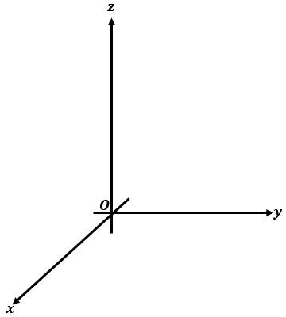


Transformers
fire
fox
student
book
internet
computer

Slide 37
Transformers
fire
fox
student
book
internet
computer

Slide 38
Transformers
fire
fox
student
book
internet
computer
Angle measures distance between words

Slide 39

Transformers
Output
X₁
X₂
X₃
S
o o
ftm
utp
Position embeddings
+
X₁
X₂
X₃
D
c
er
Token embeddin_{g}
der
Positional Encoding
Positional Encoding
Embedding
Embedding
Inputs

Slide 40


Transformers
Output
Softmax output
Decoder
Encoder
Self-attention
Self-attention
Embedding
Embedding
Inputs

Slide 41


Transformers
Output
Softmax output
Decoder
EEnEncnccododeder er r
Multi-headed Self-attention
Multi-headed Self-attention
Embedding
Embedding
Inputs

Slide 42


Transformers
Output
Softmax output
Feed forward network
Feed forward network
Decoder
Encoder
Embedding
Embedding
Inputs

Slide 43
Transformers
Output
Softmax
Softmax output
output
Decoder
Encoder
Embedding
Embedding
Inputs

Slide 44
Transformers
Output
Softmax output
P1 P2 … … … … … … … … … … … … … … … …
Decoder
… … … … … … … … … …
…
Pn
Encoder
Embedding
Embedding
Inputs

Slide 45
Transformers
Output
Translation:
sequence-to-sequence task
Softmax output
J'aime l'apprentissage automatique
Decoder
Encoder
Embedding
Embedding
Inputs

Slide 46
Transformers
Output
Translation:
sequence-to-sequence task
Softmax output
J'aime l'apprentissage automatique
Decoder
Encoder
J’a
l'apprentissage
automatique
ime
2345
3425
3853
Embedding
Embedding
Inputs

Slide 47
Transformers
Output
Translation:
sequence-to-sequence task
Softmax output
J'aime l'apprentissage automatique
Decoder
Encoder
J’a
l'apprentissage
automatique
ime
2345
3425
3853
Embedding
Embedding
Inputs

Slide 48
Transformers
Output
Translation:
sequence-to-sequence task
Softmax output
J'aime l'apprentissage automatique
Decoder
Encoder
J’a
l'apprentissage
automatique
ime
2345
3425
3853
Embedding
Embedding
Inputs

Slide 49
Transformers
Output
297
Translation:
sequence-to-sequence task
Softmax output
J'aime l'apprentissage automatique
Decoder
Encoder
J’a
l'apprentissage
automatique
ime
2345
3425
3853
Embedding
Embedding
Inputs

Slide 50
Transformers
Output
297
Translation:
sequence-to-sequence task
Softmax output
J'aime l'apprentissage automatique
Decoder
Encoder
J’a
l'apprentissage
automatique
ime
2345
3425
3853
Embedding
Embedding
Inputs

Slide 51
Transformers
Output
297
Translation:
sequence-to-sequence task
Softmax output
I
J'aime l'apprentissage automatique
Decoder
Encoder
J’a
l'apprentissage
automatique
ime
2345
3425
3853
Embedding
Embedding
Inputs

Slide 52

Transformers
Output
297
450
901
389
Translation:
sequence-to-sequence task
Softmax output
I
love
machine
learning
J'aime l'apprentissage automatique
Decoder
I love machine learning
Encoder
J’a
l'apprentissage
automatique
ime
2345
3425
3853
Embedding
Embedding
Inputs

Slide 53
Transformers
Output
Softmax output
Encoder
Encodes inputs (“prompts”) with contextual understanding and produces one vector per input token.
Decoder
Accepts input tokens and generates new tokens.
Decoder
Encoder
Embedding
Embedding
Inputs

Slide 54
Transformers
Output
Output
Output
Encoder Only Models
Decoder Only Models
Decoder
Encoder
Decoder
Encoder Decoder
Encoder
Models
Input
Inputs
Input

Slide 55
Jupyter

Slide 56
Generative configuration parameters for inference

Slide 57
Generative configuration - inference parameters
Max new tokens
Enter your prompt here…
200
Sample top K
Sample top P
Temperature
25
1
Inference configuration parameters
0.8
Submit

Slide 58
Generative configuration - max new tokens
Max new tokens
Enter your prompt here…
200
Max new tokens
Sample top K
25
Sample top P
1
Temperature
0.8
Submit

Slide 59
Generative config - max new tokens
max_new_tokens = 100
max_new_tokens = 150
Softmax
output
max_new_tokens = 200

Slide 60
Generative config - max new tokens
max_new_tokens = 100
max_new_tokens = 150
Softmax
output
max_new_tokens = 200
Stop token

Slide 61
Generative config - greedy vs. random sampling
Token probability
0.20
cake
greedy: The word/token with the highest probability is selected.
0.10
donut
Softmax
output
0.02
banana
0.01
apple
…
…
prob
word
0.20
cake
random(-weighted) sampling: select a token using a random-weighted strategy across the probabilities of all tokens.
0.10
donut
Softmax
output
0.02
banana
Here, there is a 20% chance that ‘cake’ will be selected, but ‘banana’ was actually selected.
0.01
apple
…
…

Slide 62
Generative configuration - top-k and top-p
Enter your prompt here…
Max new tokens
200
Top-k and top-p sampling
Sample top K
Sample top P
25
1
Temperature
0.8
Submit

Slide 63

Generative config - top-k sampling
prob
word
0.20
cake
top-k: select an output from the top-k results after applying random-weighted strategy using the probabilities
0.10
donut
Softmax
output
0.02
banana
k=3
0.01
apple
…
…

Slide 64
Generative config - top-p sampling
prob
word
0.20
cake
top-p: select an output using the random-weighted strategy with the top-ranked consecutive results by probability and with a cumulative probability <= p.
p = 0.30
0.10
donut
Softmax
output
banana
0.02
0.01
apple
…
…

Slide 65
Generative configuration - temperature
Enter your prompt here…
Max new tokens
200
Sample top K
25
Sample top P
1
Temperature
0.8
Temperature
Submit

Slide 66



Generative config - temperature
Temperature setting
Cooler temperature (e.g <1)
prob word
Higher temperature (>1)
prob word
0.001 | apple
0.002 | banana
0.400 | cake
0.012 | donut
… | …
0.040 | apple
0.080 | banana
0.150 | cake
0.120 | donut
… | …
Softmax
output
Strongly peaked probability distribution
Broader, flatter probability distribution

Slide 67
Prompting and prompt engineering
Prompt
Model
Completion
Where is Ganymede located in the solar system?
Where is Ganymede located in the solar system?
Ganymede is a moon of Jupiter and is located in the solar system within Jupiter’s orbit.
LLM
Context window: typically a few thousand words

Slide 68
GenAI Concepts
Token
A token is the smallest unit of text that a language model recognizes, such as a word, part of a word, or even individual characters.
Prompt
A prompt is the input provided to a language model, consisting of text or instructions that guide the generation of a response.
Completion
Completion refers to the response generated by a language model in response to a prompt, completing the text according to the provided context.
Prompt Window Size
The size of the prompt window is the maximum number of tokens that a language model can process at once, including both the prompt and the completion.
Inference
Inference is the process by which a language model generates responses or predictions based on the input received, applying the knowledge acquired during training.

